Slide 1


Ministry of Higher Education and Scientific Research
Carthage University
National Institute of Applied Sciences and Technology
TRAJECTORY CONTROL OF THE ATLAS ROBOT IN AGRICULTURAL ENVIRONMENTS
Presented by:
Presented on:
University supervisor:
Company supervisor:

Slide 2
04
CONCLUSION
03
Probléme & Solution
02
DevSecOps
01
INTRODUCTION

Slide 3
INTRODUCTION

Slide 4
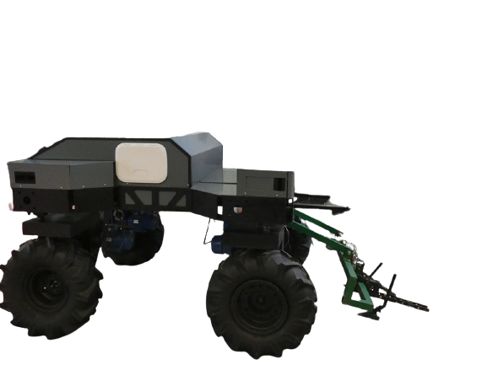
Problem
ATLAS now
Ezzayra
Objectives
Introduction
Remotely controlled
Rechargeable using solar
panels
Detects & Follows a farmer
Guided with GPS

Slide 5
Problem
Ezzayra
Objectives
Introduction
ATLAS
1
Robot is not capable of being autonomous in olive tree fields
2
GPS is inaccurate within 5 meters

Slide 6
Problem
Problem
Ezzayra
Objectives
Objectives
SOLUTION
Introduction
Autonomous course correction
in an olive field using an RGB camera

Slide 7
Problem
Ezzayra
Objectives
Hence our objectives,
Introduction
Suggest a live streaming on site architecture
3
2
Calculate the line that will be followed by ATLAS
Detect olive tree lanes
1
Notes:
So basically OUR objectives are
First, detect olive tree lanes, 2 calculate the line that should be followed by our robot and finally suggest a live streaming architecture for the robot connection to a server.

Slide 8
OBJECT DETECTION
Notes:
Model type , comparison

Slide 9
Constrain& requirements
Models’
comparison
Model types
Model
choice
Object detection
HEAD
(detector)
02
Neural Network-based
object detection methods
01
BACKBONE
Notes:
neural based methods are the state of the art with a proven efficiency, they were used in previous research to detect vine trees, apple trees, fruits and so on
So the they have a common architecture that is composed of :
A Backbone that Extracts the features that the performance of the detector depends on.
Generally researchers repurpose classification networks to perform the feature extraction task
And a Head where the detection occurs

Slide 10
Constrain& requirements
Models’
comparison
Model types
Model
choice
Object detection
ONE-STAGE METHODS
TWO-STAGE METHODS
Low Inference
High Inference
HEAD
splits models into
Lower Accuracy
Higher Accuracy
Architecture:
No per proposal classification
Architecture:
Per proposal classification
Example:
SSD Single Shot Detector
YOLO You Only Look Once
Example:
R-CNN Region Based Convolutional Neural Networks
R-FCN Region-based Fully Convolutional Networks
Notes:
So object detection methods are divided into two categories because of the difference in the head’s architecture.
One stage methods and two stage methods
So one stage methods have a high FPS which is the number of frames per second which comes at the cost of accuracy. On the opposite side, two stage metjods, perform well accuracy wise yet achieve a very low FPS
The difference in architecture is that two stage methods use per proposal classification.
We choose two examples from each type and we compare

Slide 11
Constrain& requirements
Models’
comparison
Model types
Model
choice
Object detection
Limited Computational Resources
Small Dataset
Limited timeline
CONSTRAINTS
REQUIREMENTS
Real-time detector
Higher FPS
Results in
Lower accuracy
Notes:
In order to achieve course correction for the robot we needed a real time detection which means a higher FPS which came at the cost of accuracy .
As for our constraints we had to deal with limited access to computational resources, and since manual image annotation is extremely laborious, we opted for the use of a smaller dataset! This was all more accentuated with time limitations set by the internship.

Slide 12
Constrain& requirements
Models’
comparison
We compared methods using literature
Model types
Model
choice
Object detection
 | R-FCN | Faster R-CNN
Dataset | MS COCO | MS COCO
Threshold | 0.5 | 0.5
AP | 48.9% | 48.4%
FPS | 5 | 2
 | SSD | YOLOv4
Dataset | MS COCO | MS COCO
Threshold | 0.5 | 0.5
Input Image size | 512x512 | 512x512
AP | 28.8% | 43%
FPS | 28 | 31
Notes:
So we found out that it is very costly and unfeasible to train and then test each model on our own dataset in order to compare their performance.
This led us to compare models through literature and we saw that yolov4 has the highest FPS with an AP that is decent.

Slide 13

Constrain& requirements
Models’
comparison
Model types
Model
choice
Object detection
We chose
HIGH FPS
FLEXIBLE STRUCTURE
GOOD
ACCURACY
BAG OF FREEBIES &
BAG OF SPECIALS
Notes:
So we chose yolov4 which in addition has a flexible structure and both bag of freebies and bag of specials.
Bag of freebies is a set of techniques that can be used to enhance accuracy without influencing the FPS and bag of specials that is a set of plugins and post processing methods that slightly influence the FPS yet widely improve accuracy.

Slide 14
IMPLEMENTATION & RESULTS
1
Dataset
4
Live streaming
3
Course correction
2
YOLOv4
Notes:
So implementation and results is split into 4 sections

Slide 15
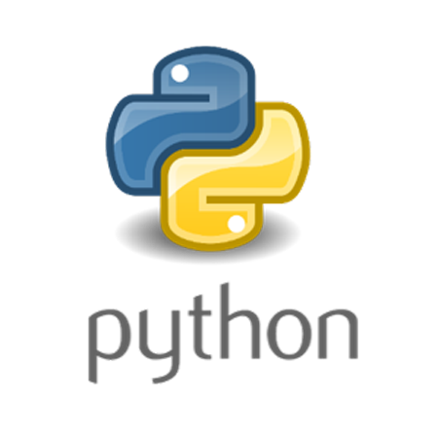
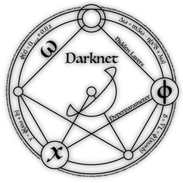
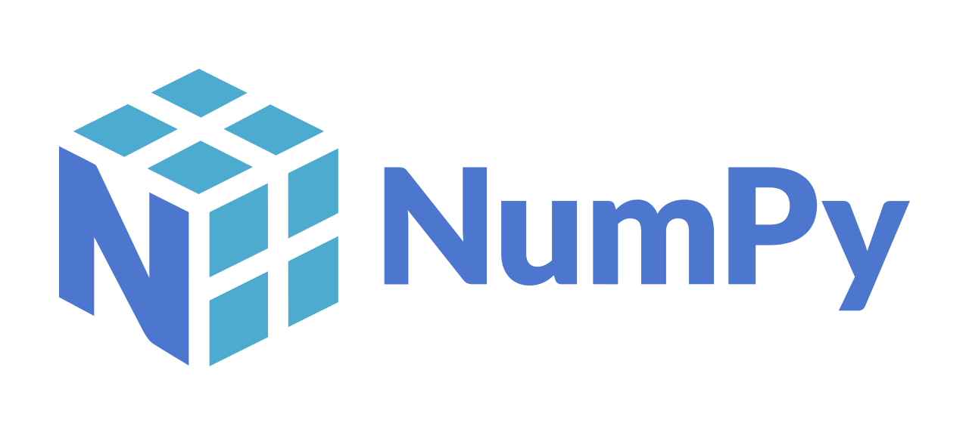

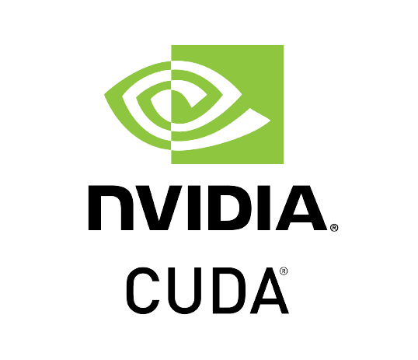

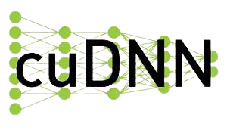
Notes:
We used python as the coding language and these libraries for training, testing and managing the dataset

Slide 16

DATASET

Slide 17
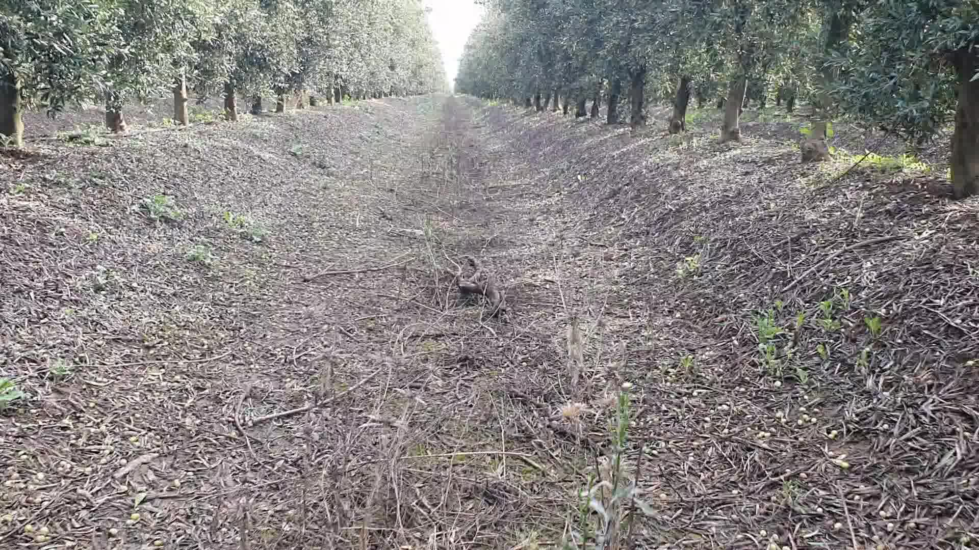
1920
YOLOv4
Course correction
Dataset
Livestreaming
Implementation
& Results
I
1080
IMAGE ACQUISITION
Notes:
We need a dataset of Tunisian olive trees so we used a 30fps, 1080p RGB camera to take videos of our clients olive tree fields
From each video we extracted frames such as the image shown here.

Slide 18
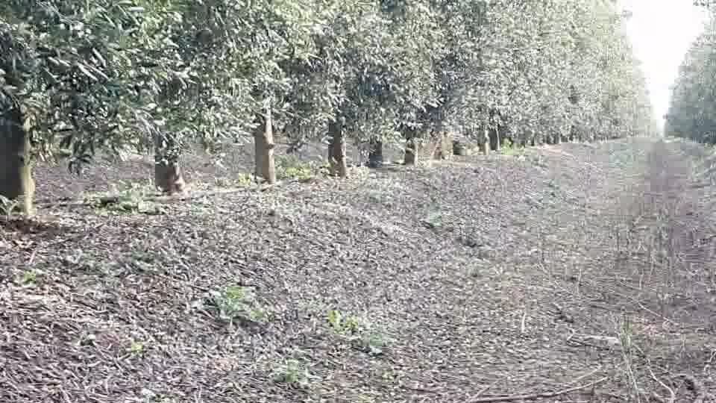
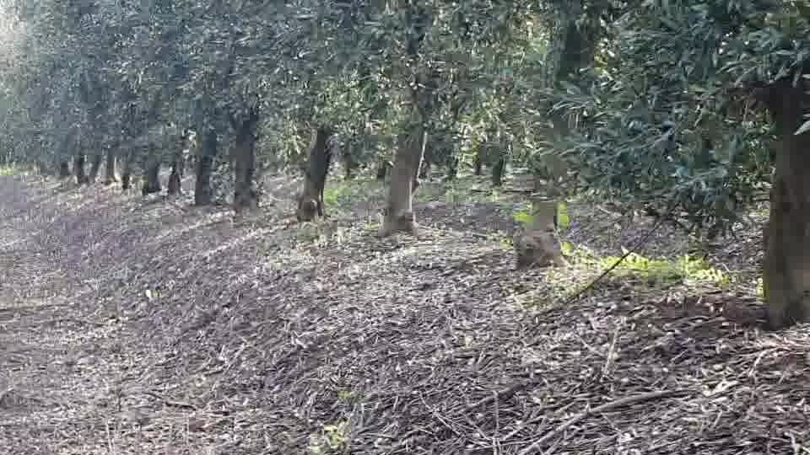
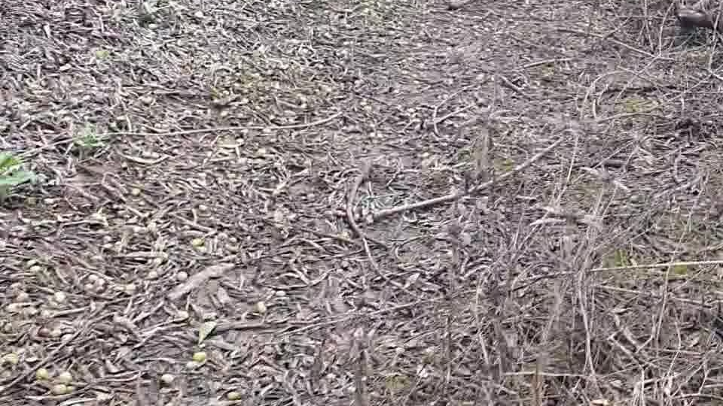
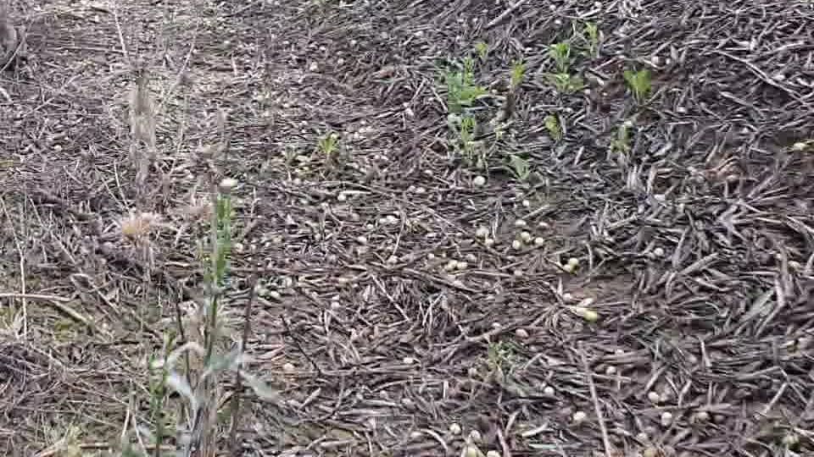
YOLOv4
Course correction
960
Dataset
Livestreaming
Implementation
& Results
540
I
IMAGE ACQUISITION
Notes:
We split each image into 4 images! And We hit two birds with one stone!
We expanded our dataset and we provided an exact number of images that don’t contain any objects! This will help the model distinguish between a foreground and a background object.

Slide 19
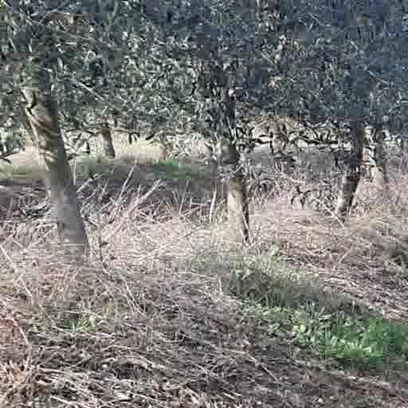
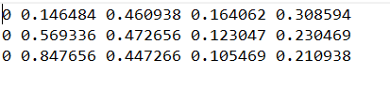
YOLOv4
Course correction
Dataset
Livestreaming
Implementation
& Results
2
IMAGE ANNOTATION
Object-id
X-center
Y_centre
Width
Height
Notes:
The next step is to annotate the entire dataset. We encircle each tree trunk with a rectangle and we get a file with the same image name containing each bounding box’s … normalized! This is a very important step

Slide 20
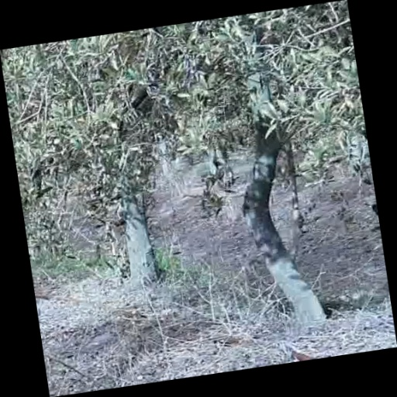
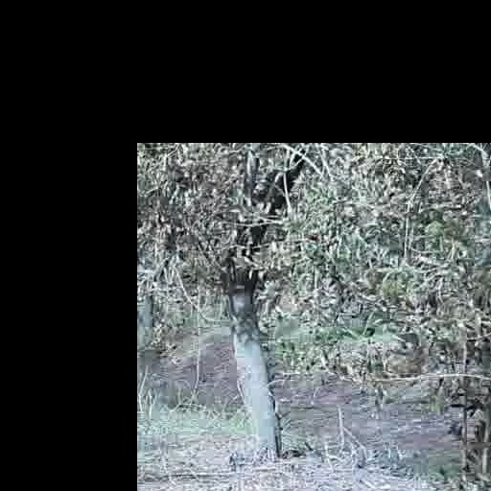
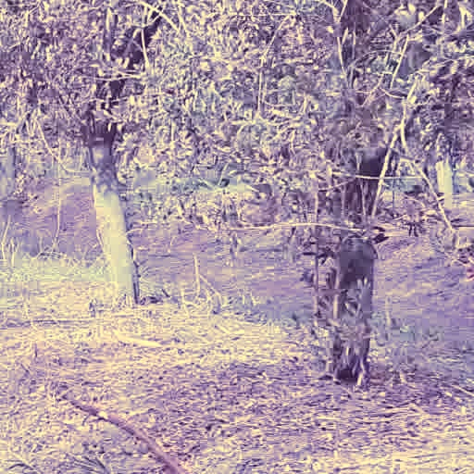
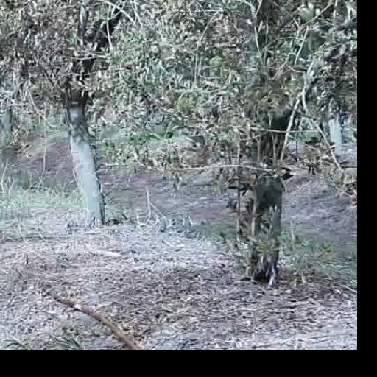
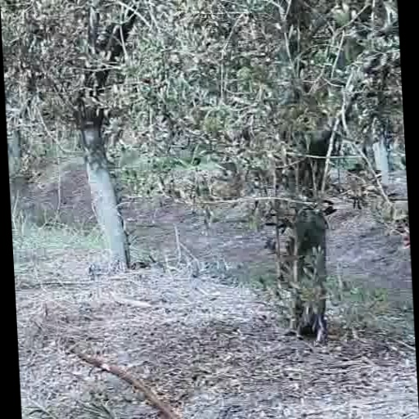
GEOMETRIC DISTORTION
PHOTOMETRIC
DISTORTION
YOLOv4
Course correction
Dataset
Livestreaming
Implementation
& Results
3
Rotation
Translation
HSV modifications
IMAGE DATA AUGMENTATION
Scaling
Shearing
Notes:
The next step is to apply image data augmentation which will expand our dataset and help us solve the occlusion problem.
Rotation translation

Slide 21
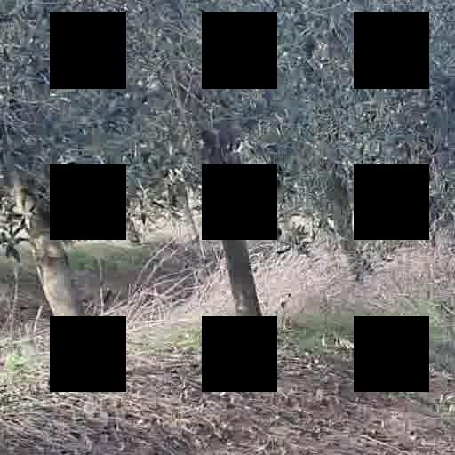
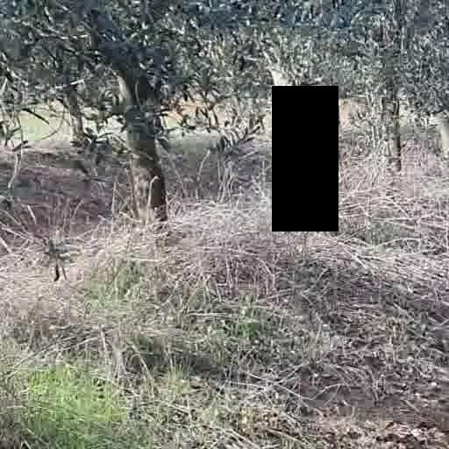
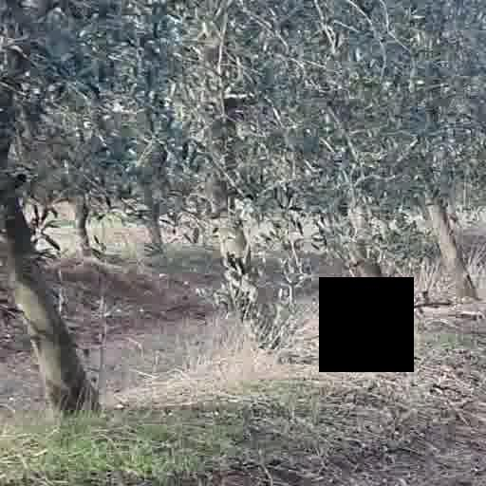
YOLOv4
Course correction
Dataset
Livestreaming
SELECTION FROM BAG OF FREEBIES
Implementation
& Results
3
IMAGE DATA AUGENTATION
GridMask
Random Erase
Cutout
Notes:
We picked a selection of data augmentation methods from bag of freebies which included deletion of portions from our images
In the form of a grid, a random rectangle or a uniform square in cutout

Slide 22
YOLOv4
Course correction
Dataset
Livestreaming
We split our dataset into
Implementation
& Results
4
DATASET PRODUCTION
Notes:
Finally, we split our dataset. 90% of it is dedicated for training
And the rest is for validation as in testing

Slide 23
You Only Look Once : YOLOv4

Slide 24
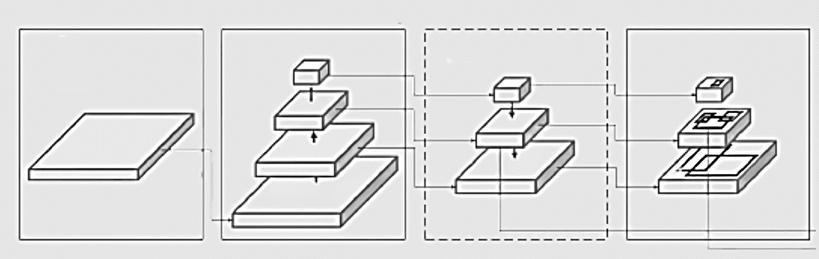
YOLOv4
Course correction
Architecture
YOLOv4
Dataset
Livestreaming
Implementation
& Results
Input Image
Head
Backbone
Neck
Notes:
Yolov4’s architecture is as follows:

Slide 25
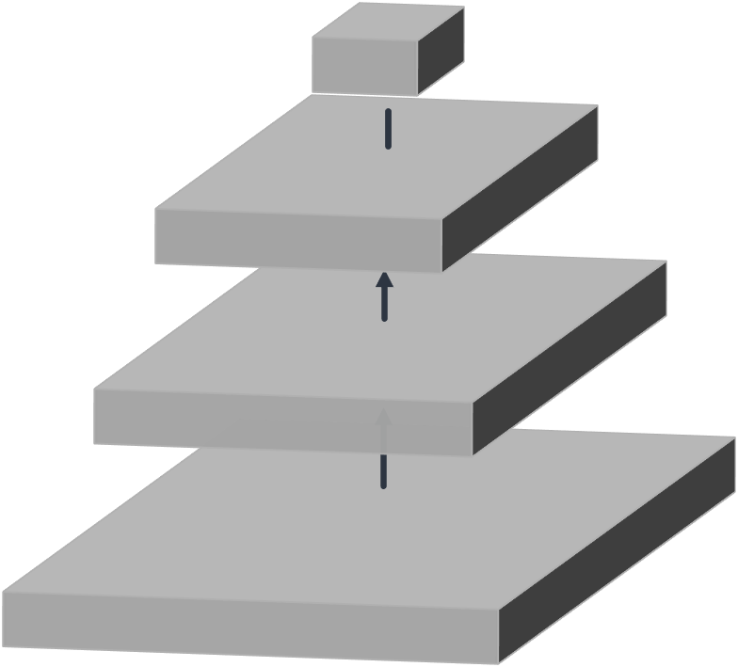
YOLOv4
Course correction
Backbone
YOLOv4
Dataset
Livestreaming
Implementation
& Results
BAG OF FREEBIES
DropBlock regularisation
Chosen & Applied to
2. Class label smoothing regularisation
BAG OF SPECIALS
Backbone
CSPDarknet53
Mish Activation
4. Cross-stage partial connections
Notes:
Csp darknet had the highest nb of parameters thus it is capable of detecting multiple objects in an image and it has shown in their experiments that it gives a high AP at an impressive FPS
For the backbone we choose from each bag a selection of methods to improve accuracy
From bag of freebies we chose dropblock and class label smoothing to avoid overfitting and from bag of special we chose mish as the activation function and Cross-stage partial connections to increase the frequency of gradient learning by the layers.

Slide 26
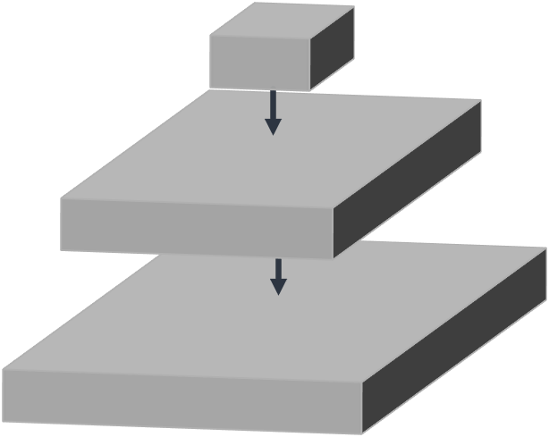
YOLOv4
Course correction
Dataset
Livestreaming
Implementation
& Results
Neck
YOLOv4
Spatial pyramid pooling
SPP Block
Path Aggregation Networks PANet
Enhance receptive field
Path Aggregation for instance segmentation
Notes:
Next we move to the neck part
The neck components are selected in order to first enhance the receptive field which is the space in the input that produces a feature. SPP is used for its capacity to expand the receptive field without causing speed reduction
In order to enhance info flow in the network to achieve instance segmentation which is the identification, classification and localization of instances on the pixel level.
PANet is chosen for instance segmentation in YOLOv4 because of its ability to preserve spatial information accurately which helps in proper localization of pixels for mask formation.

Slide 27
YOLOv4
Course correction
Head
YOLOv4
Dataset
Livestreaming
Implementation
& Results
1. Centre coordinates, height, width
Predict
A vector for each bounding box
2. Prediction confidence
3. label

Slide 28
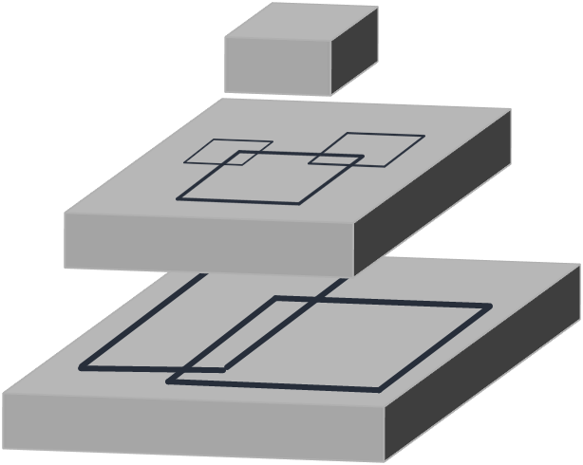
YOLOv4
Course correction
Dataset
Livestreaming
Implementation
& Results
Head
YOLOv4
BAG OF FREEBIES
DropBlock regularisation
2. CIoU Loss
BAG OF SPECIALS
3. Cross mini batch Normalization
4. Mish Activation
5. SAM BLOCK
6. DIoU NMS
Notes:
From bag of freebies we use dropblock, ciou loss to achieve a better accuracy and from bag of specials we use cross mini batch to solve the memory consumption problem, mish activation, sam block to focus the networks learning on valuable information like the objects that need to be localized instead of background information, and Diou non max suppression because it takes distance between bounding boxes into consideration.

Slide 29
RESULTS

Slide 30
YOLOv4
Course correction
YOLOv4
RESULTS
Dataset
Livestreaming
Implementation
& Results
  Model trained for
  7800 iterations
On validation set we get:
  Average Loss = 2.55
    True Positives
    = 77.93%
  AP = 79.13%
Notes:
We train the model for 7800 itartions which is when a batch has passed through the entire network.

Slide 31
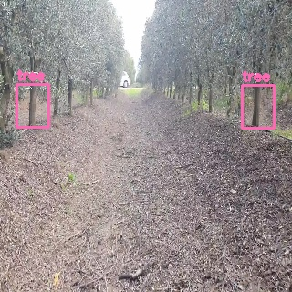
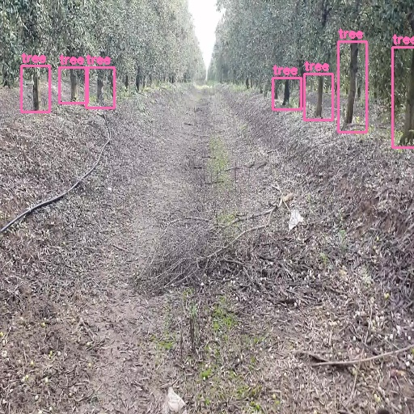
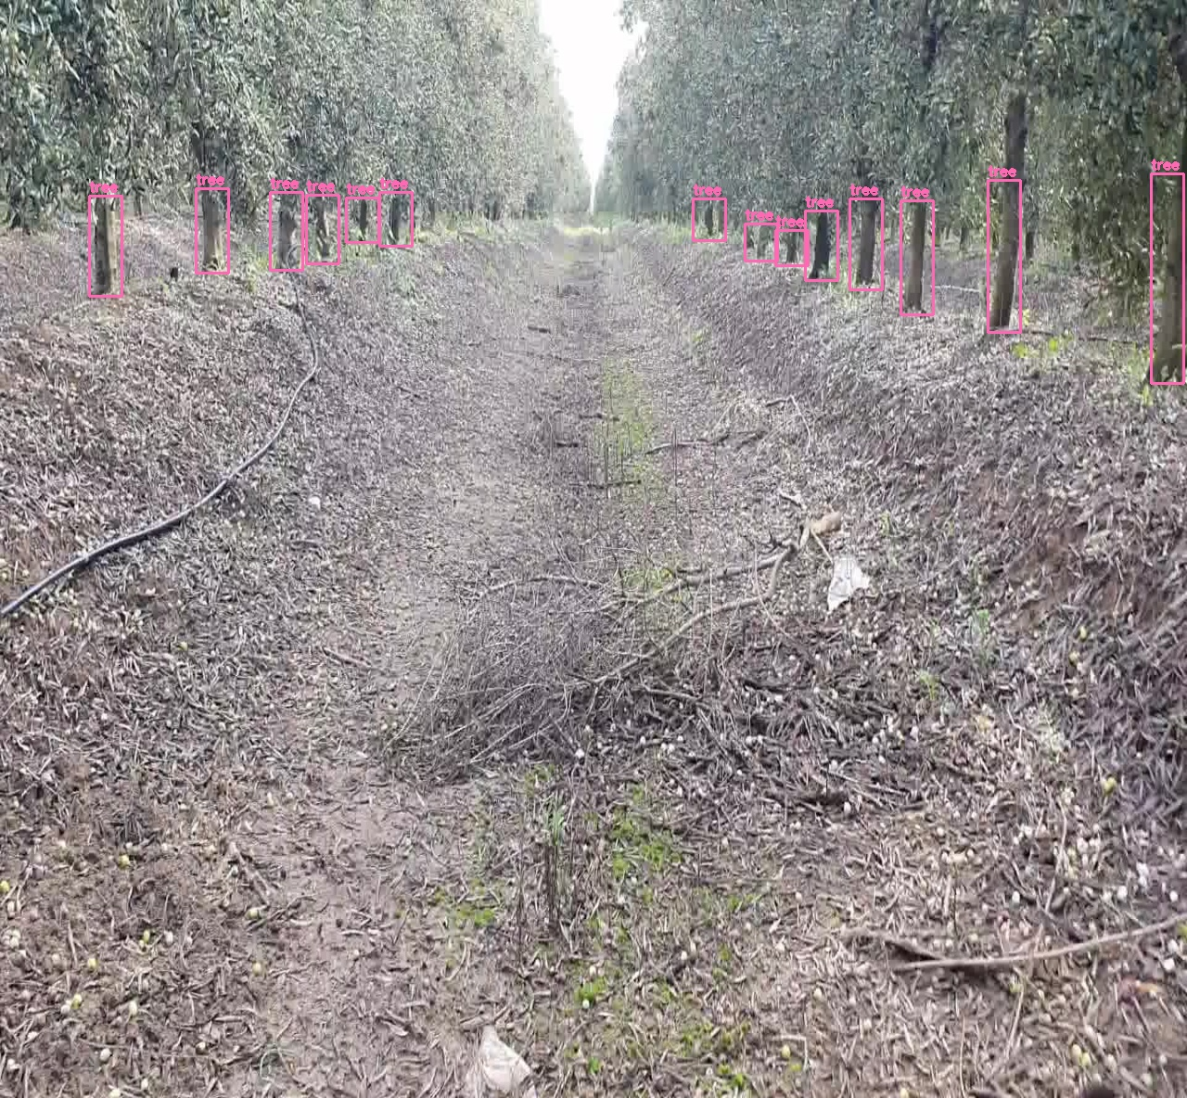
YOLOv4
Course correction
YOLOv4
RESULTS
Dataset
Livestreaming
Implementation
& Results
TEST ON DATASET
320x320
512x512
1280x1184
Notes:
We tested the model on our own dataset
For a very small image of size 320p, the model is capable of detecting the very first tree trunks
Obviously when the image gets way bigger, even farther away tree trunks are detected

Slide 32
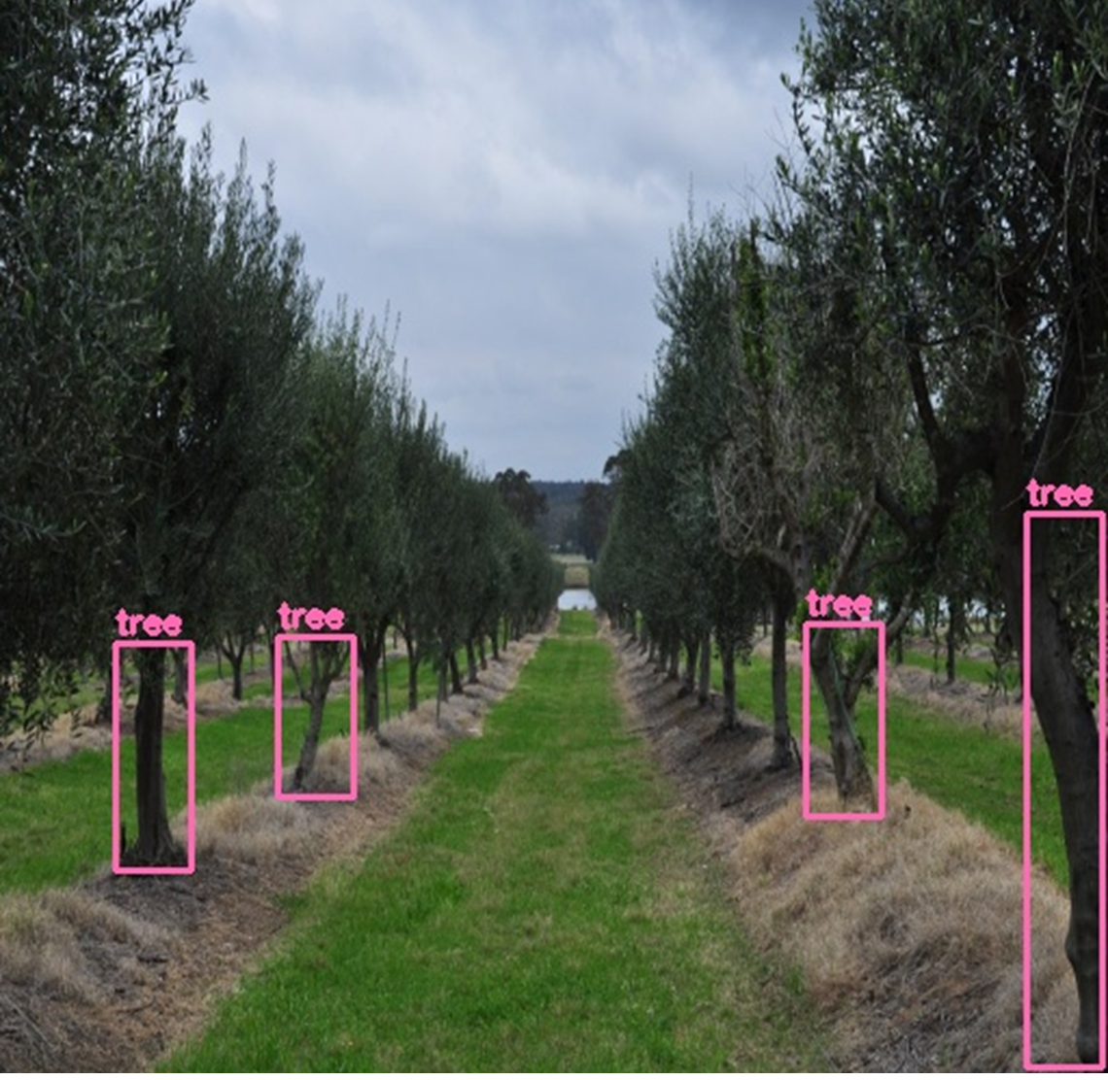
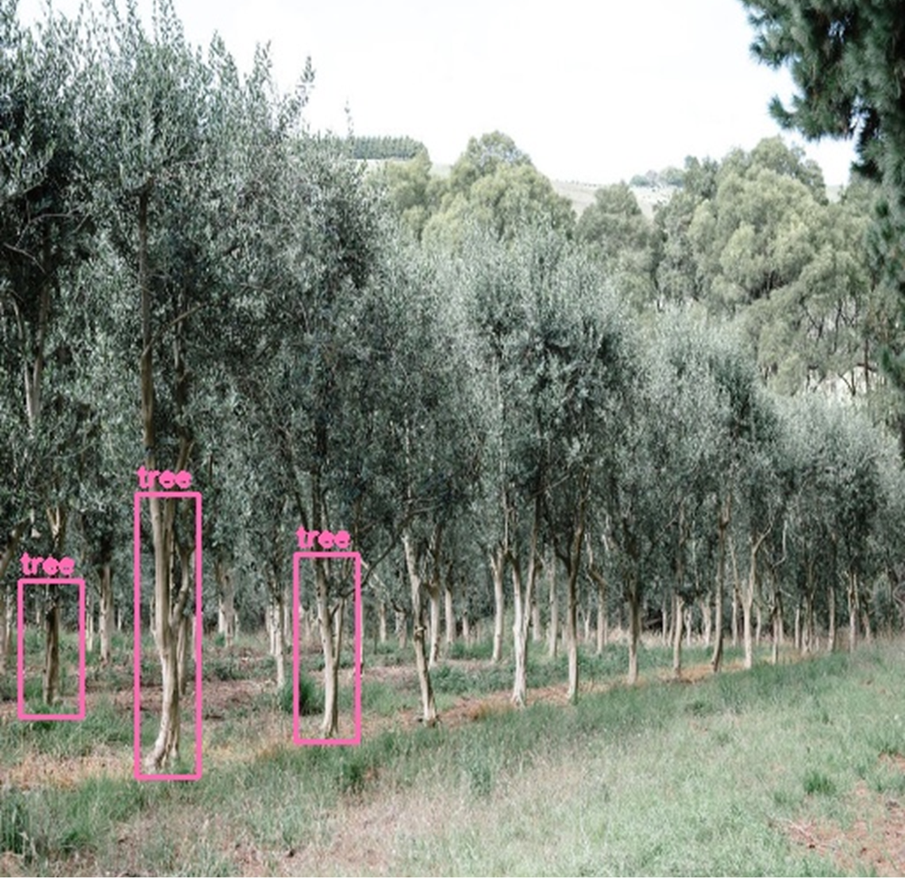
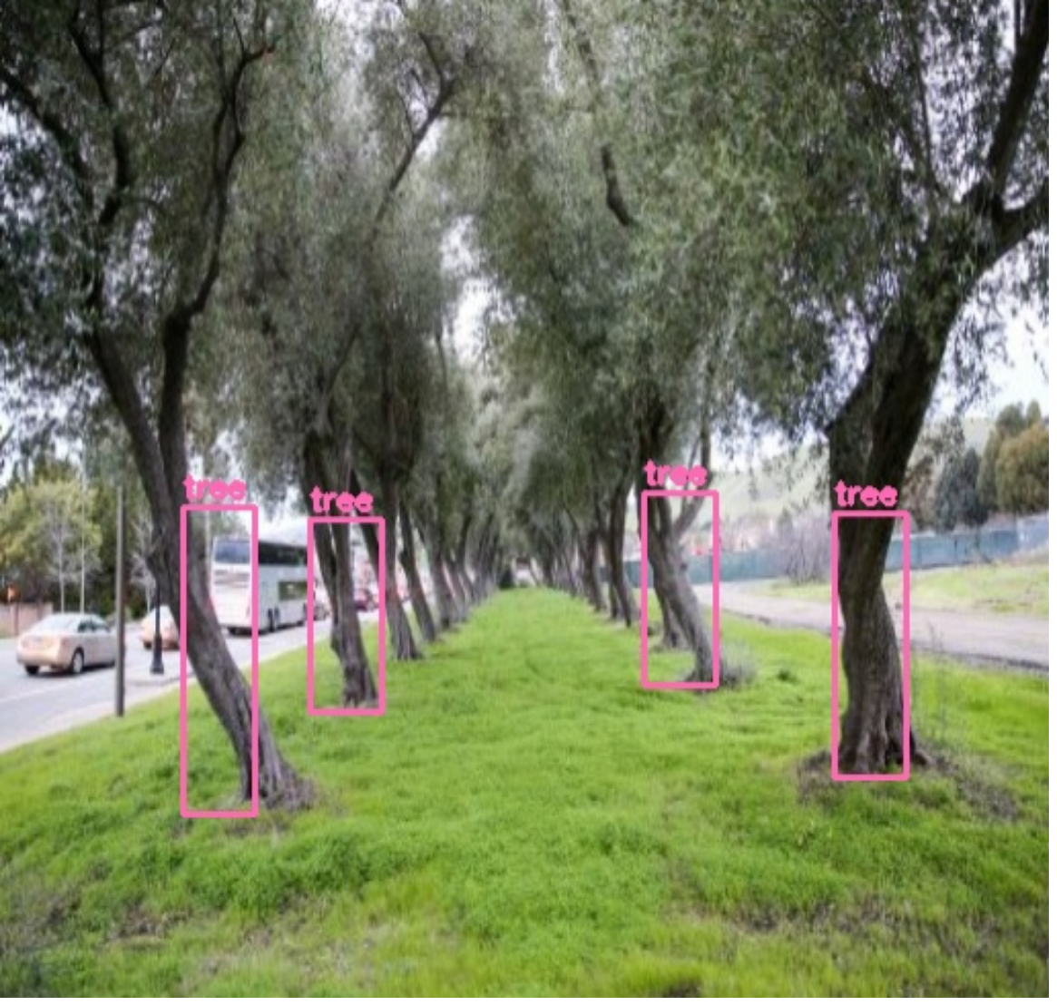
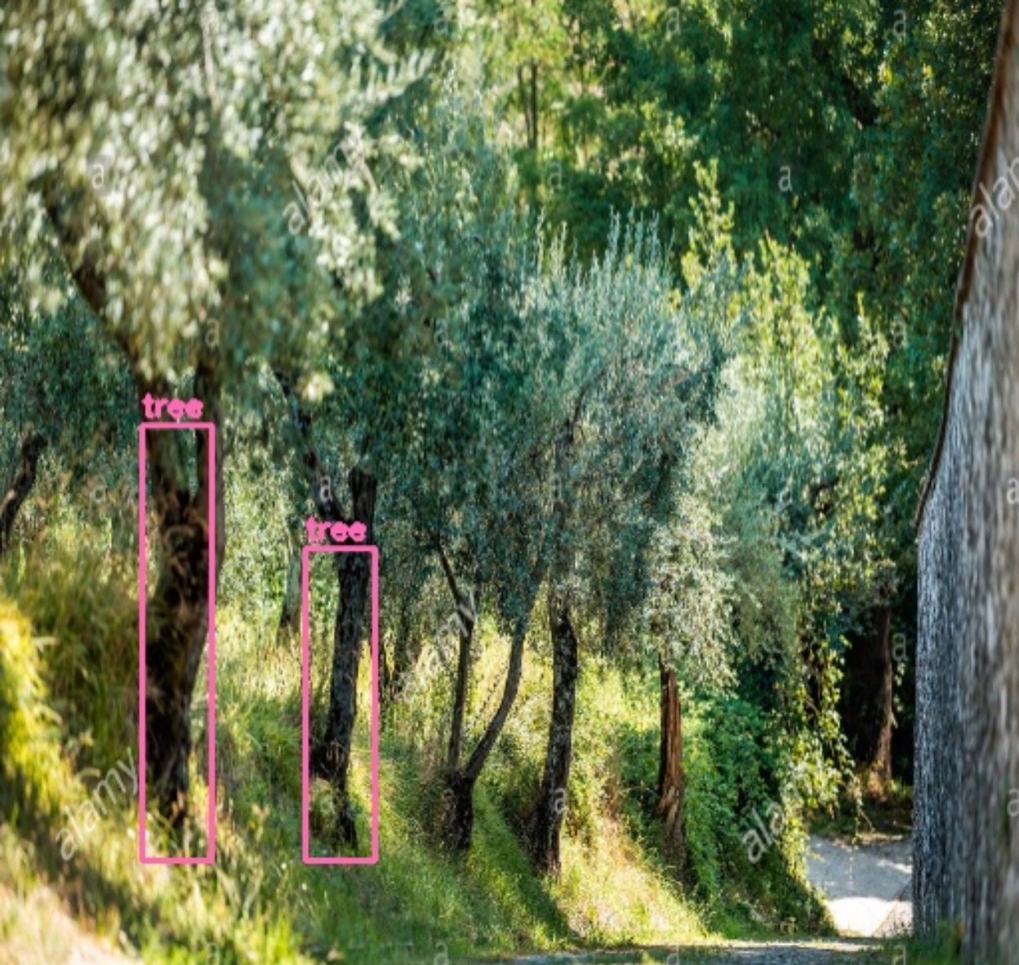
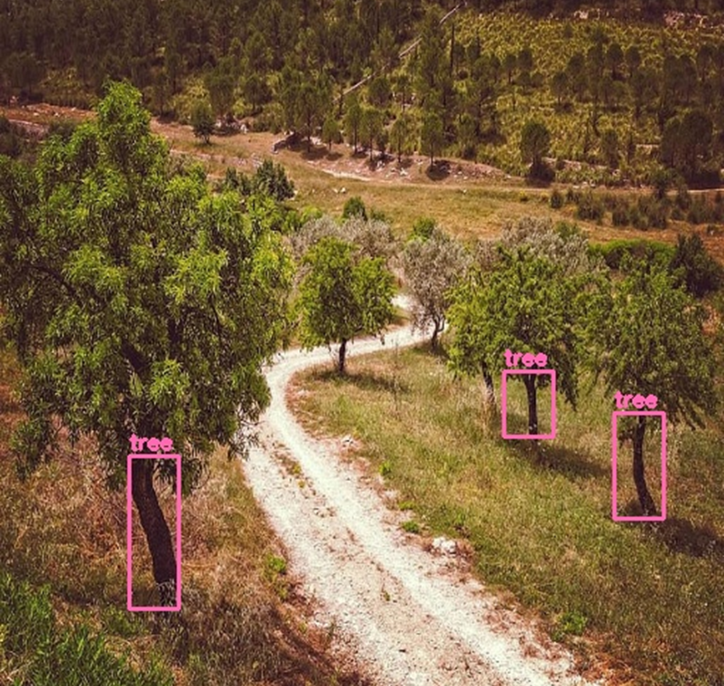
YOLOv4
Course correction
YOLOv4
RESULTS
TEST ON OTHER IMAGES
Dataset
Livestreaming
Implementation
& Results
Notes:
We needed other images to see how efficient the model is! With different camera angles, lighting and tree trunks! It was capable of detecting our object

Slide 33

YOLOv4
Course correction
YOLOv4
RESULTS
Dataset
Livestreaming
Implementation
& Results
FPS is 16
For images of
size 960x832
FPS is 40
For images of size 512x512
Notes:
When we tested the FPS, we found that for a video size of 512p, FPS is extremely high! Naturally, when we increase the image size FPS decreases however it still is very efficient for our robot because of its slow pace. OFC these values can increase if we use better hardware

Slide 34
Course Correction

Slide 35
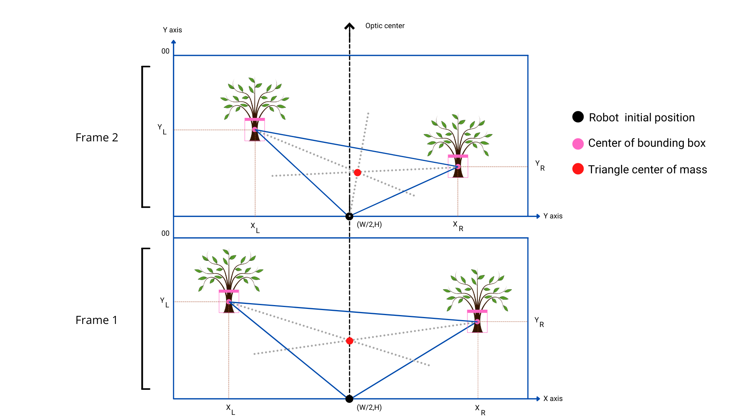
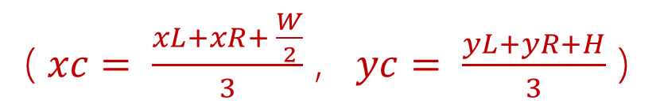
YOLOv4
Course correction
Track correction
TRACK MEASUREMENT
Dataset
Livestreaming
Implementation
& Results
Notes:
For our track correction! We create a triangle using the first two trees and the robot point. The mass center represents the centre of the path which is calculated as u see.

Slide 36
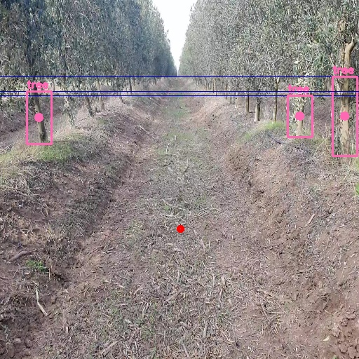
YOLOv4
Course correction
Track correction
TRACK MEASUREMENT
Dataset
Livestreaming
Implementation
& Results
Notes:
This is an example where we calculate the centre of the path on one of our images

Slide 37
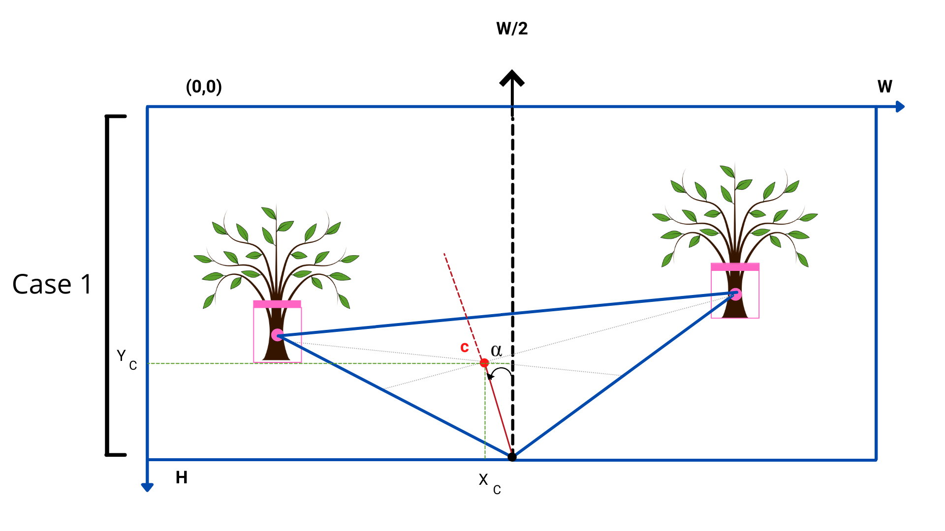
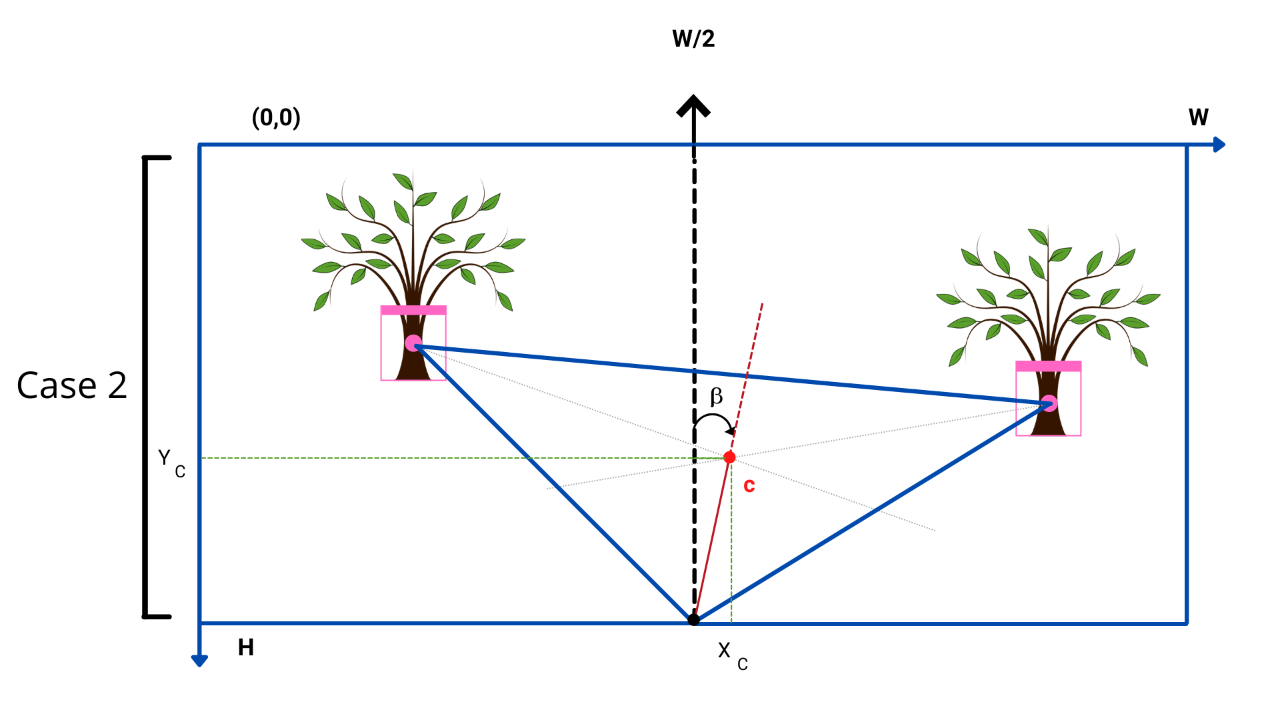
YOLOv4
Course correction
Track correction
COURSE CORRECTION
Dataset
Livestreaming
Implementation
& Results
Notes:
For course correction, depending of the placement of the centre point with reference to the optic axis we calculate the angles alpha and beta as follows

Slide 38
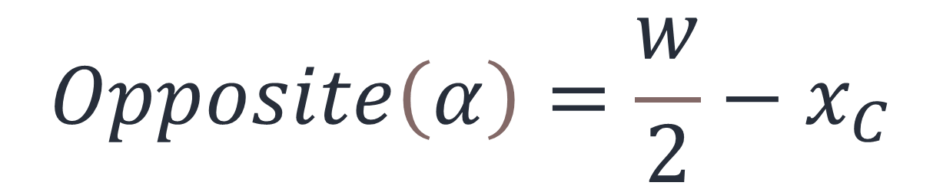
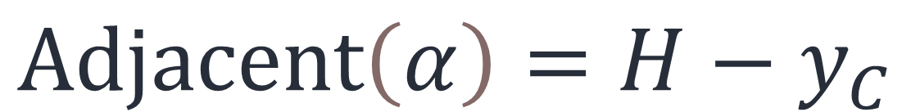
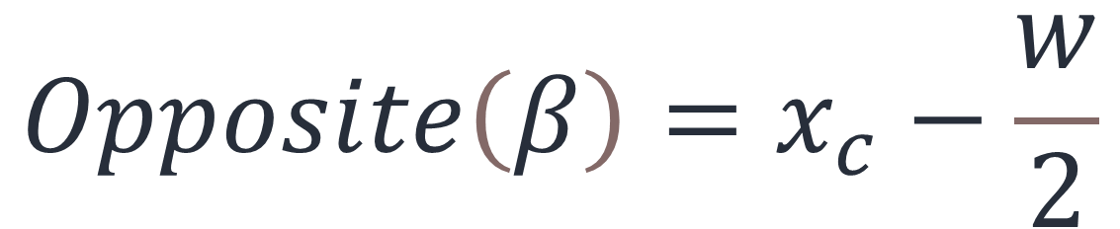
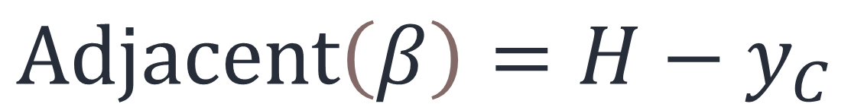
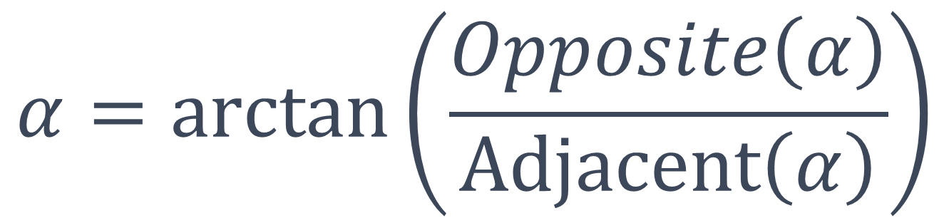
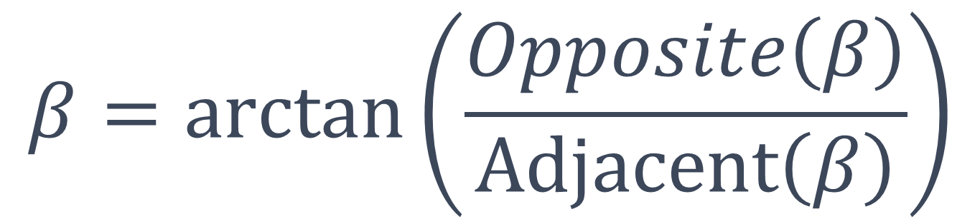
YOLOv4
Course correction
Track correction
COURSE CORRECTION
Dataset
Livestreaming
Implementation
& Results
We calculate
Therefore

Slide 39


YOLOv4
Course correction
Track correction
COURSE CORRECTION
Dataset
Livestreaming
Implementation
& Results
We calculate
Angle of deviation θ
OR
Notes:
And we calculate the angle of rotation theta which depends on alpha or beta

Slide 40
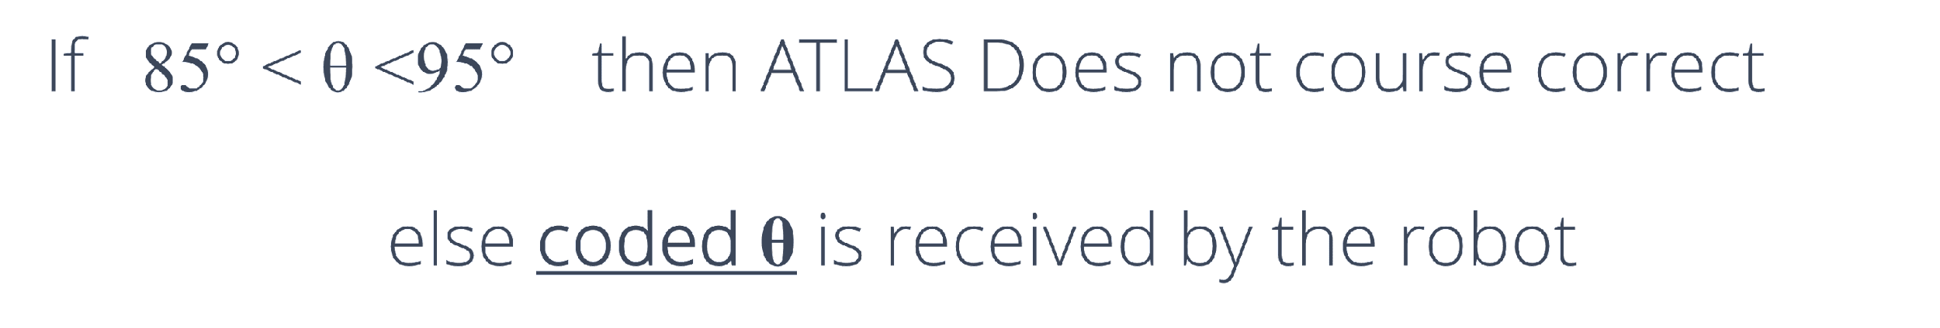
YOLOv4
Course correction
Track correction
COURSE CORRECTION
Dataset
Livestreaming
Implementation
& Results
Depending on
Angle of deviation θ
Notes:
If the angle theta is between 85 and 95, our robot doesnt course correct! Else we send the angle coded in the form of a character.

Slide 41
CONCLUSION & OUTLOOK

Slide 42
1
Accuracy is high but could be increased
2
Number of iterations gave good results but could increase
3
Dataset was efficient but could expand
4
Generalization is achievable by adding other tree types
5
Live streaming could not be tested
6
Efficient hardware VS a smaller model
Notes:
The results given by the model are promising despite the low nb of iterations! The loss value can decrease with more training and a bigger dataset
Our dataset is small because of how laborious labeling is. But a more generalized and bigger dataset can improve performance and insure generalization. We suggest collecting images from videos taken by atlas while its achieving its tasks in the future.
For live streaming, we could not test the architecture for the lack of computationally efficient server, however, we saw that only live streaming over two different networks without applying object detection gave a low FPS. In order to avoid network problems we suggest using a strong computer on the robot to deploy yolov4 directly on it or using tiny yolov4 on raspberry pi which will cost us a drop in accuracy.

Slide 43
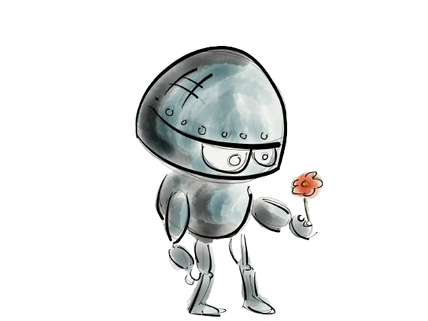
THANK YOU FOR YOUR ATTENTION

